Slide 1
_{ONU}
Make money
…with your friends
By Glory Jain, Ben Strobaugh, Kim Santiago, Kobi Felton, Kyle Feng

Slide 2
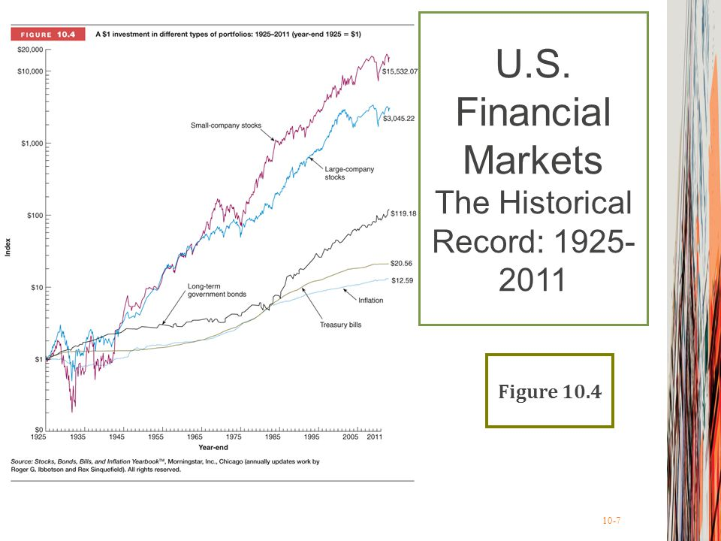
Best way to invest in future
Stocks
No resources
Current college students
Social Media
Always connected
More…

Slide 3
Stock Returns Versus Bond Returns:
Lowest record
of student stockerholders
10%
5 year avg return
12.6%
1 year avg
return

Slide 5
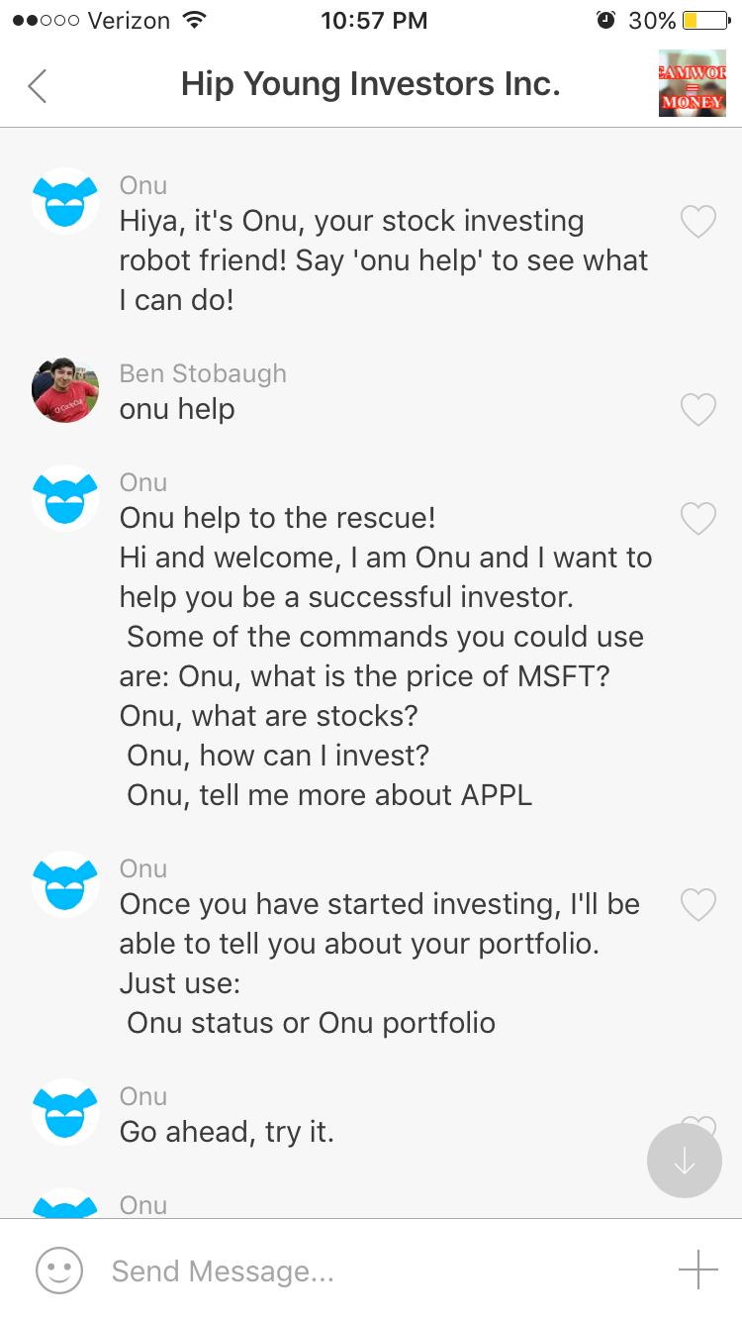
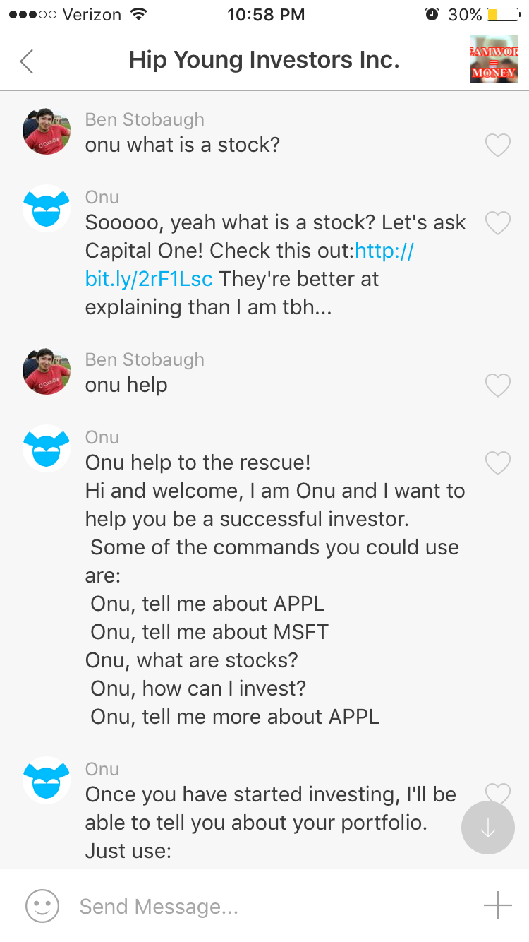
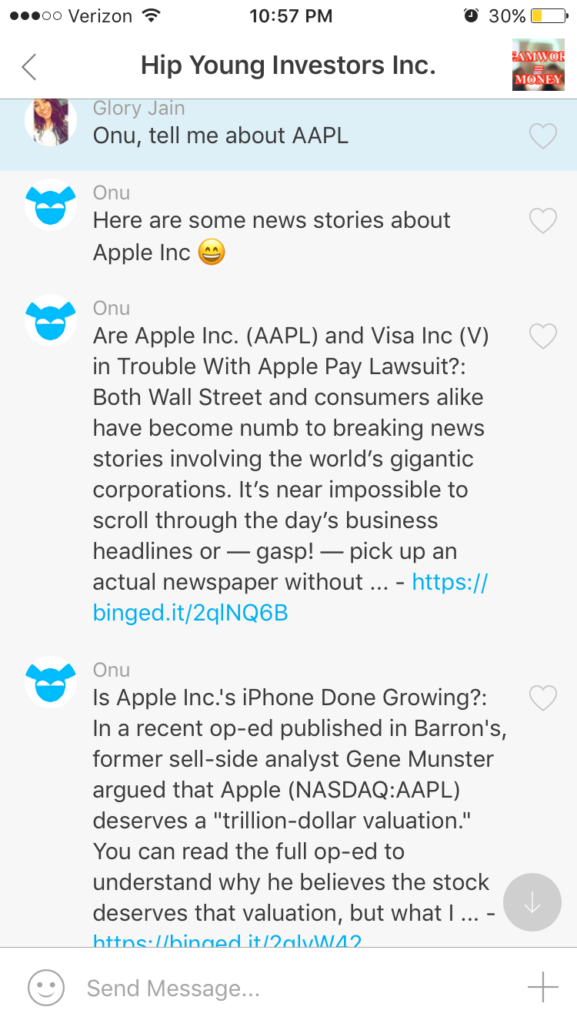

Slide 6





Slide 7
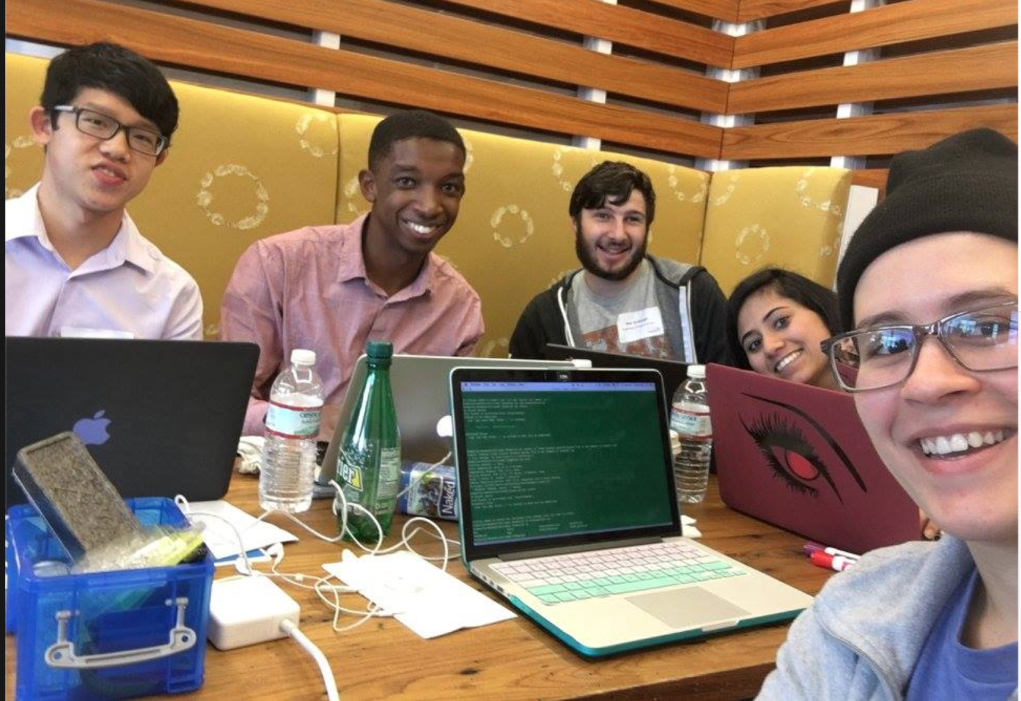
_{ONU}
Thank you!

